Slide 1


Slide 2

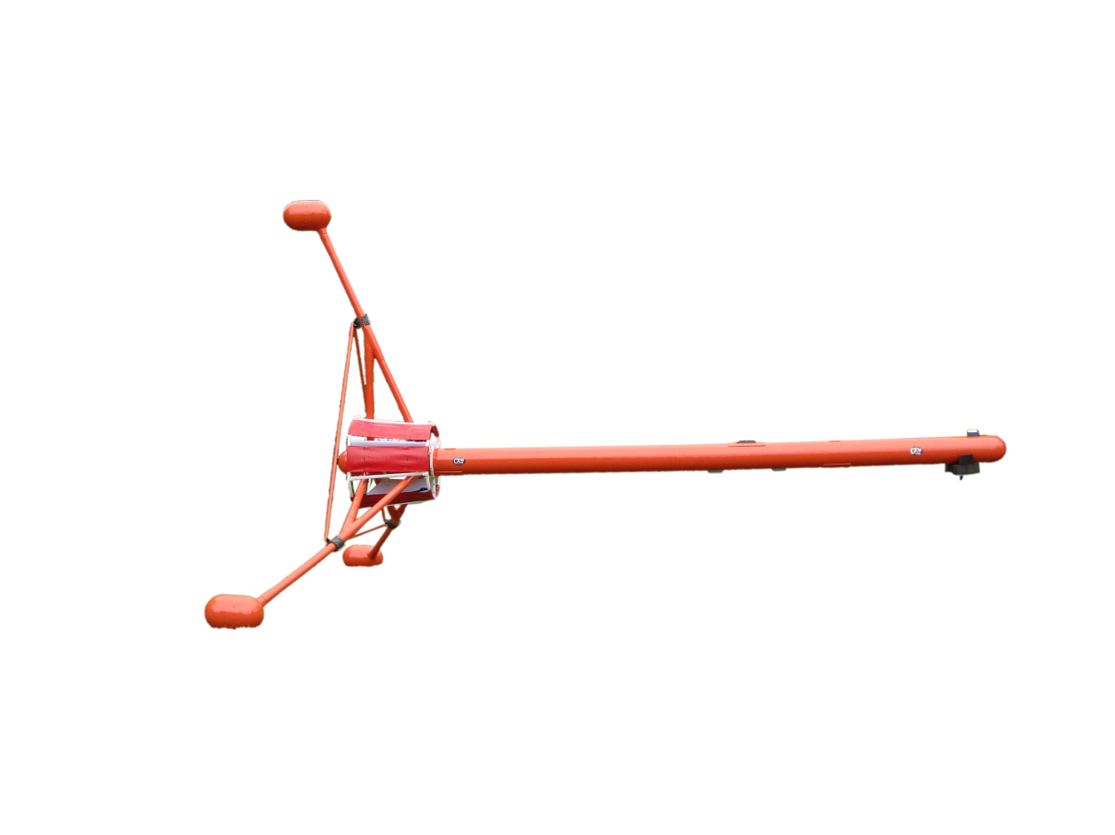
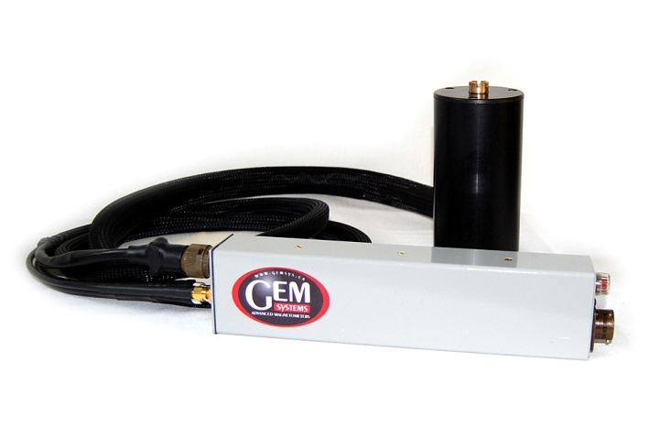
New Generation of High Sensitivity Airborne Potassium Magnetometers
Taiwan, 2012
Michael Wilson
Director, Production
www.gemsys.ca
mike.wilson@gemsys.ca

Slide 3
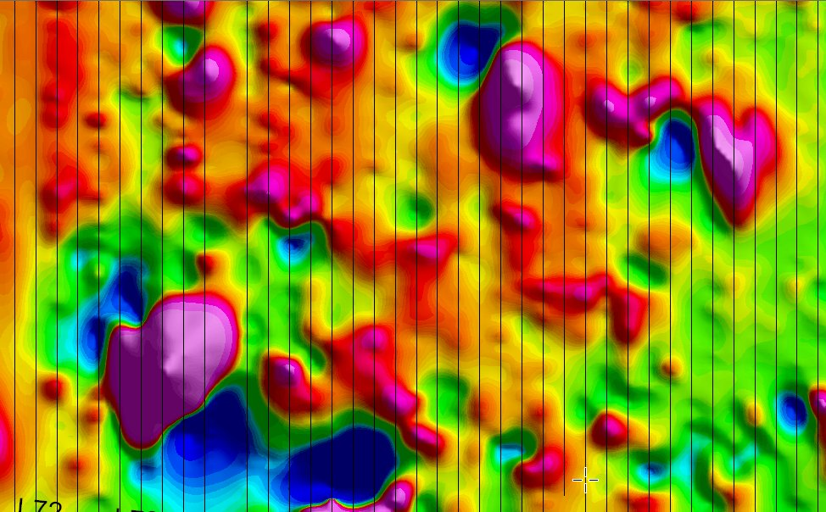
Overview
Airborne Trends in Mineral Exploration
Why Potassium?
Benefits of Potassium Vapour Magnetometers
How we did it!
Bird’s family
Gradiometers – Rationale
Tri-Directional Gradiometer – Bird
GEM DAS
Sample Customer Maps
Conclusion

Slide 4
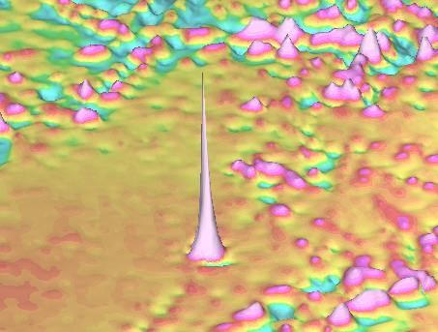
Airborne Trends in Mineral Exploration
Last 5 years it has seen a number of key trends that affect
the implementation of any new airborne technology:
High Resolution Data
More Information from Data
Better Positioned Data
Safe Acquisition
Cost Effective Acquisition
Notes:
Review of industry literature indicates that there are five key driving factors in airborne exploration …

Slide 5
Why Potassium?
• Highest Sensitivity:
Standard sensitivity 0.0005nT @ 1Hz (Model GSMP-35A) and optional High sensitivity 0.0001nT @ 1 HZ (Model GSMP-30A) are available.
• Minimal Heading Error:
less than 0.05nT for high data quality. The composite spectral line of other vapor magnetometers changes its shape as a function of sensor orientation in the magnetic field, resulting in a significant heading error (+/- 1 nT). In contrast, the Potassium single line has virtually no dependence on sensor field orientation.
• Perfect System
for multi-sensor airborne applications, with highest absolute accuracy +/- 0.05nT for effectiveness in operation of gradiometers and multi-sensor gradiometers. The single regular spectral line operation guarantees an absolute accuracy surpassing the absolute accuracy of other vapor magnetometers <3 nT
Notes:
Potassium conceived by GEM as a technology to help address industry trends and needs …
Characteristics of Potassium make it ideal for effective data acquisition …

Slide 6

Potassium Principles - Spectral Lines
4 Narrow Spectral Lines approximately 100 nT apart in 50,000 nT field
Narrow, symmetrical lines a key enabler of the technology
Affect sensitivity and gradient tolerance … GEM developed gradient optimization procedures (2002)
Sweep and “lock” on to first line
345
346
347
Frequency, KHz
Notes:
Potassium differs from Cs technology
Main difference is in spectra – very thin (1 nT) versus wide (20 nT)
Narrow Potassium spectra minimizes heading error

Slide 7
Potassium Principles - Polarization
3
Spontaneous
decay
Light Polarization
Absorption
2
1
RF Depolarization
Notes:
Images shows the basic principles of optically pumped magnetometry.
Electrons in levels 1 and 2 are polarized by light and move to level 3.
Unstable therefore decay so eventually all electrons in level 1. Cell becomes transparent.
Depolarize to return electrons to level 2
Detect light modulation as cell turns opaque and transparent … convert to frequency and magnetic units

Slide 8
Potassium Principles - Sensor
Circular Polarizer
Photo measurement
K-lamp
Filter
Potassium bulb
Notes:
Components of a sensor:
Light for polarizing
Filter for selecting only electrons in D1 spectral line
Circular polarizer for selecting electrons in level 2 for polarization
Light bulb containing metal in gaseous form
De-polarization coils
Photo multiplier for counting light modulation frequency

Slide 9
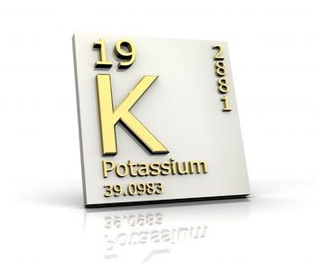
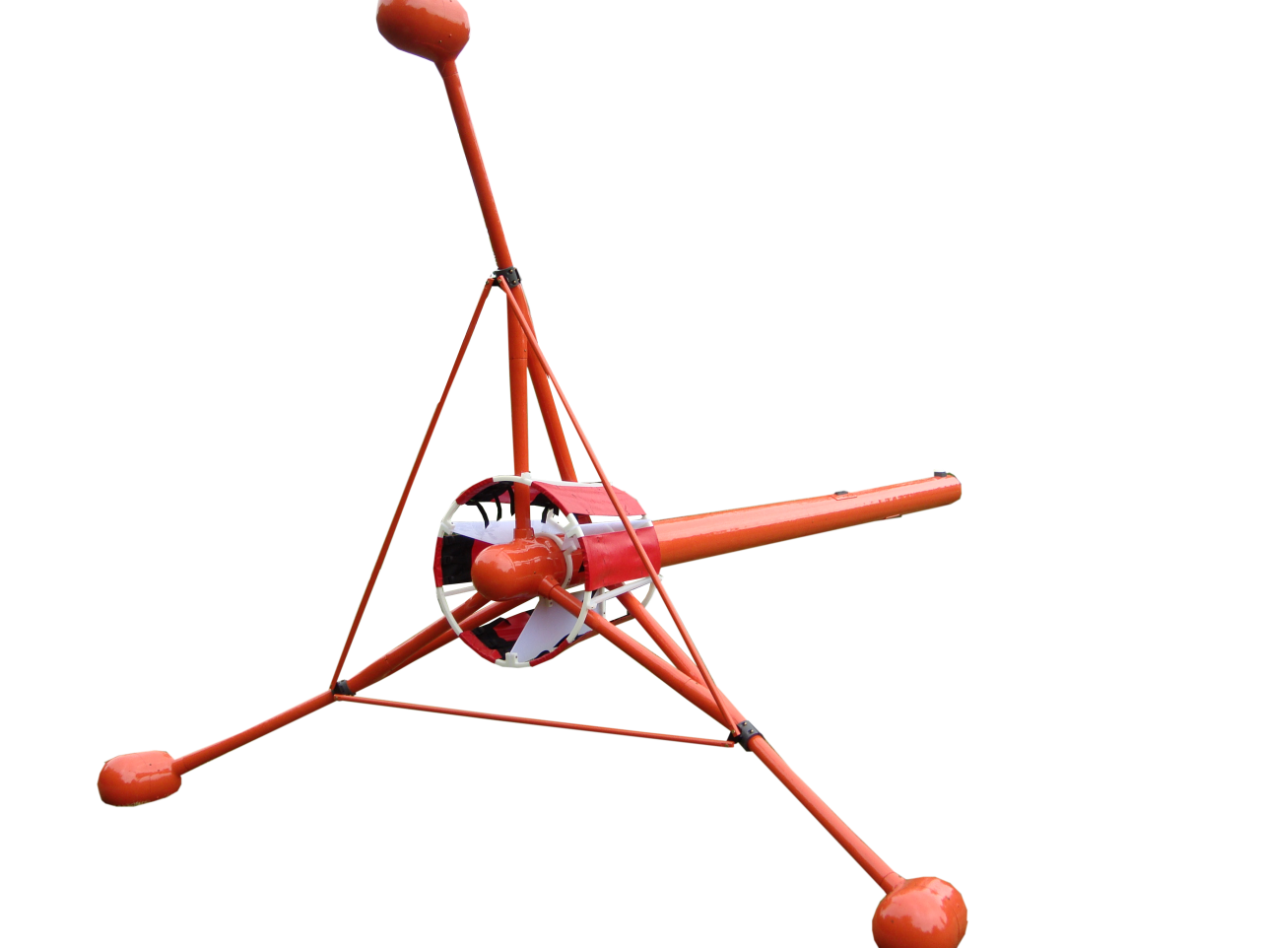
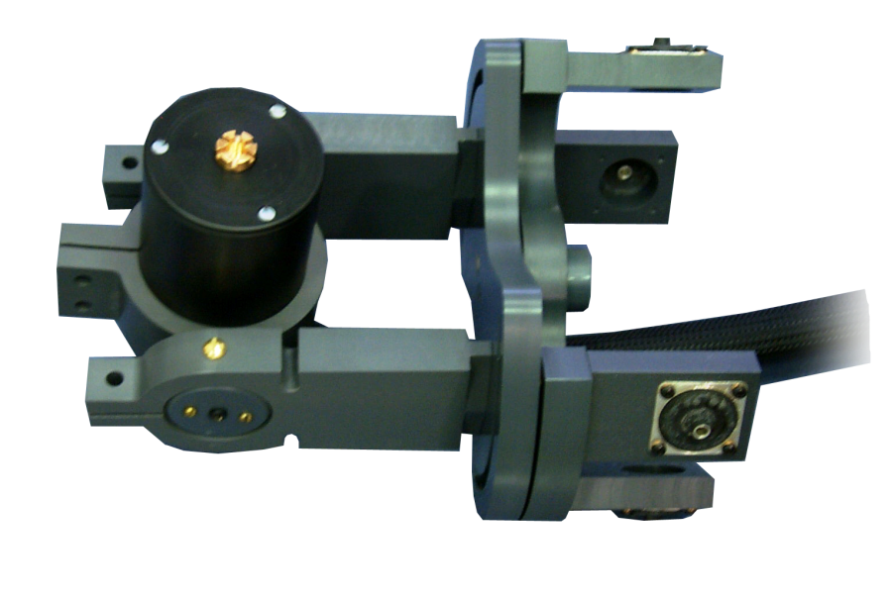
Benefits of Potassium
Vapour Magnetometers

Slide 10
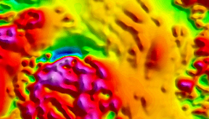
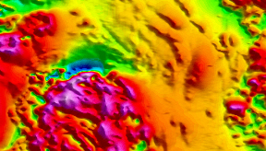
Increased Sensitivity
Increased Sensitivity of 0.5 pT
Better than other magnetometers
Increased Sensitivity
Lower Sensitivity

Slide 11
Absolute Accuracy
Accuracy of +/- 0.05 nT between sensors
Notable improvement over other sensors +/- 3 nT
Two K-Mag sensors over same source
< 0.1 nT

Slide 12
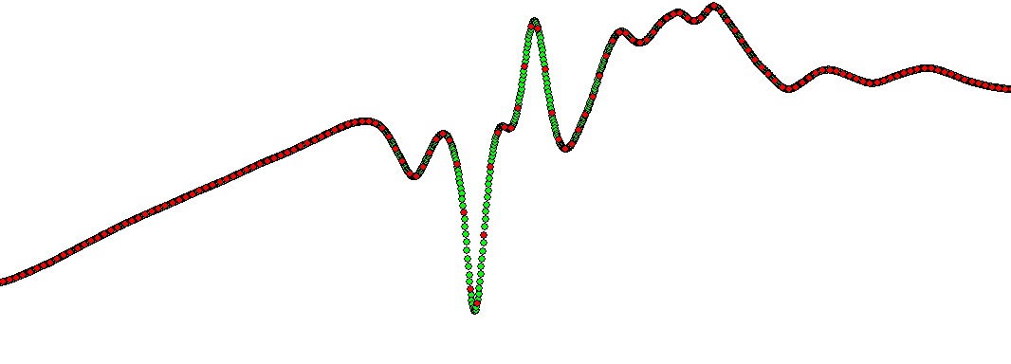
Sampling Rates
Faster sampling rates of 20 Hz and greater
2x or grater improvement over other sensors
Higher inline data density
High Freq. Data Sampling
Low Freq. Data Sampling
High Gradient Area

Slide 13
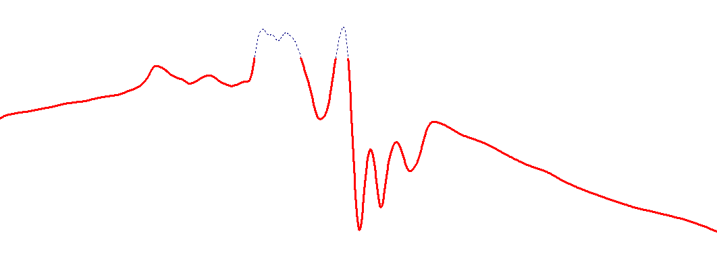
Gradient Tolerance
20,000 to 120,000 nT dynamic range boundary (20% higher than other sensors)
Capable of measuring gradients of up to 35,000 nT/m
120,000 nT
100,000 nT
Clipped Data
20k – 100k nT Dynamic Range

Slide 14
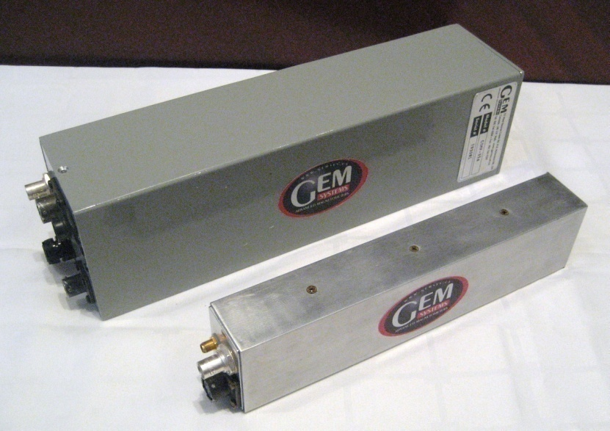
How We Did It!
By Redesigning the complete system:
• Ruggedized Electronics and Sensor
• Add Memory for Back-up purposes
• Compact electronic Box
• Light weight 630 grams

Slide 15
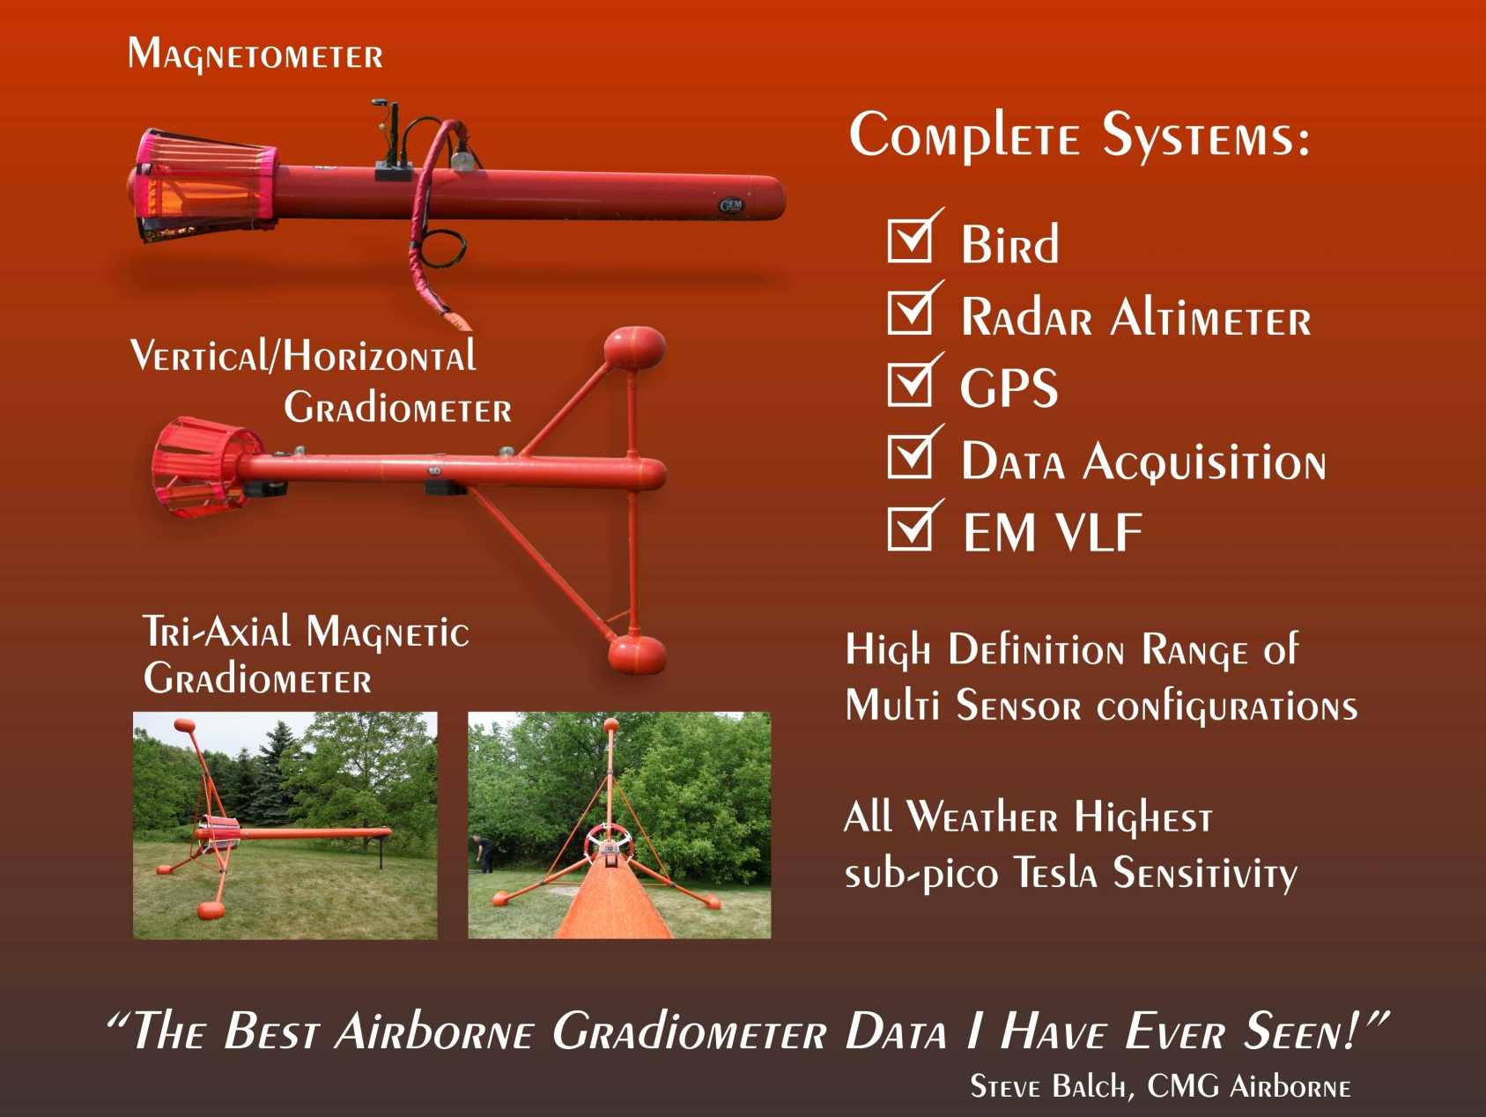
Advanced Airborne Systems
By Designing New Bird’s Family:
Notes:
Comprehensive solution available from GEM for fixed-wing applications
Includes all hardware components
Custom software solutions also available

Slide 16
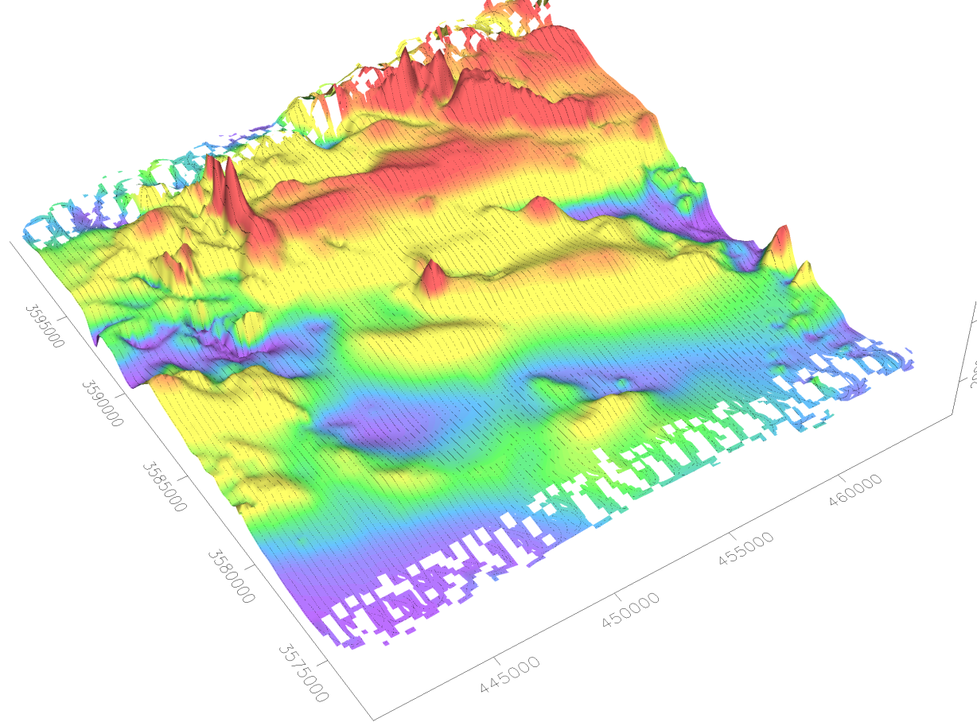
Helicopter – Magnetic Data
“You have designed and built a great piece of equipment! ”
Alan Davies, P.Eng., V.P. Exploration, Talmora Diamond Inc.
Notes:
Sample data collected in Mexico for silver exploration
High quality data; resolves subtle structures and alteration

Slide 17
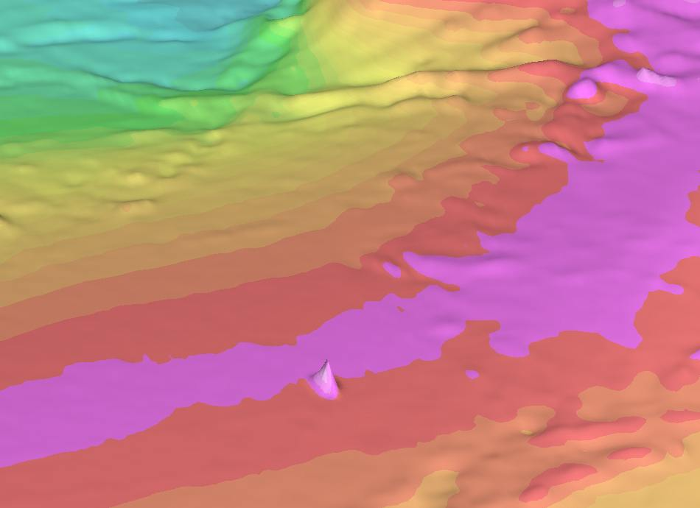
Gradiometers - Rationale
Focusing on increased spatial resolution and detail; small anomalies on the flanks of large features can be clearly resolved
Vertical gradient information used in vertical gradient maps, analytic signal maps and Euler products
Longitudinal and horizontal gradient used to improve the accuracy and resolution of magnetic maps
Detection of even the smallest source can be achieved with a line spacing of up to 2 times height above magnetic source (Scott Hogg, et al, 2004)
Magnetometer data
Gradiometer data
Improved Resolution of Small Targets
Notes:
Variety of reasons that gradiometers are coming into vogue.

Slide 18
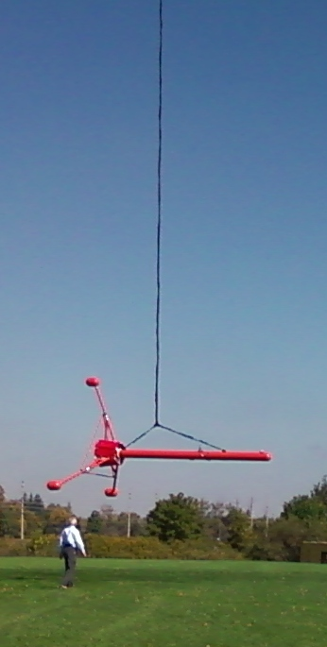
Tri-Directional Gradiometer Bird
Fins are spaced at 120 degrees to allow for simple
calculation of gradients in all three directions:
Average magnetic field of the two lower fins falls beneath the upper fin sensor to allow for vertical gradient calculation
Average of all three sensors falls in the centre of the bird shell to allow for simple determination of along-track gradient
Two lower fins used to calculate across-track gradient
Notes:
Tri-Directional Gradiometer is implemented on a specially designed bird

Slide 19
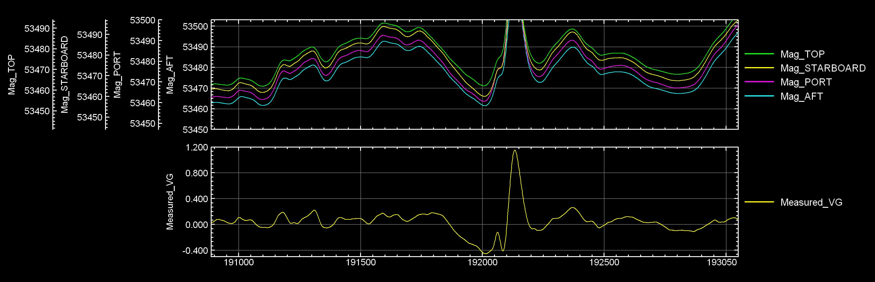
Raw Profiles – Vertical Gradient Data
Notes:
Image shows bird lifting off for survey
Show location of four sensors

Slide 20
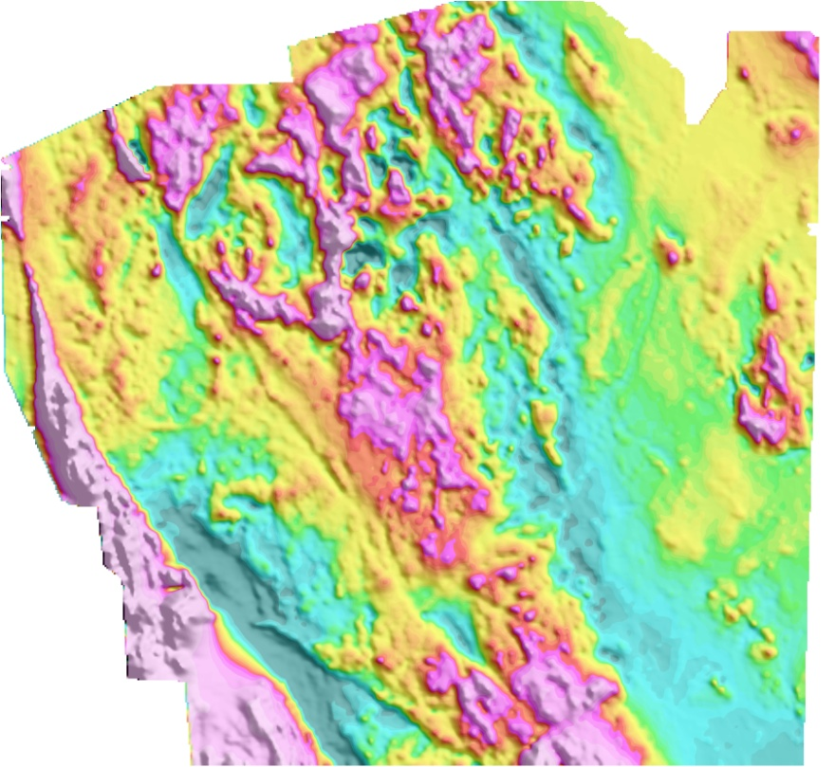
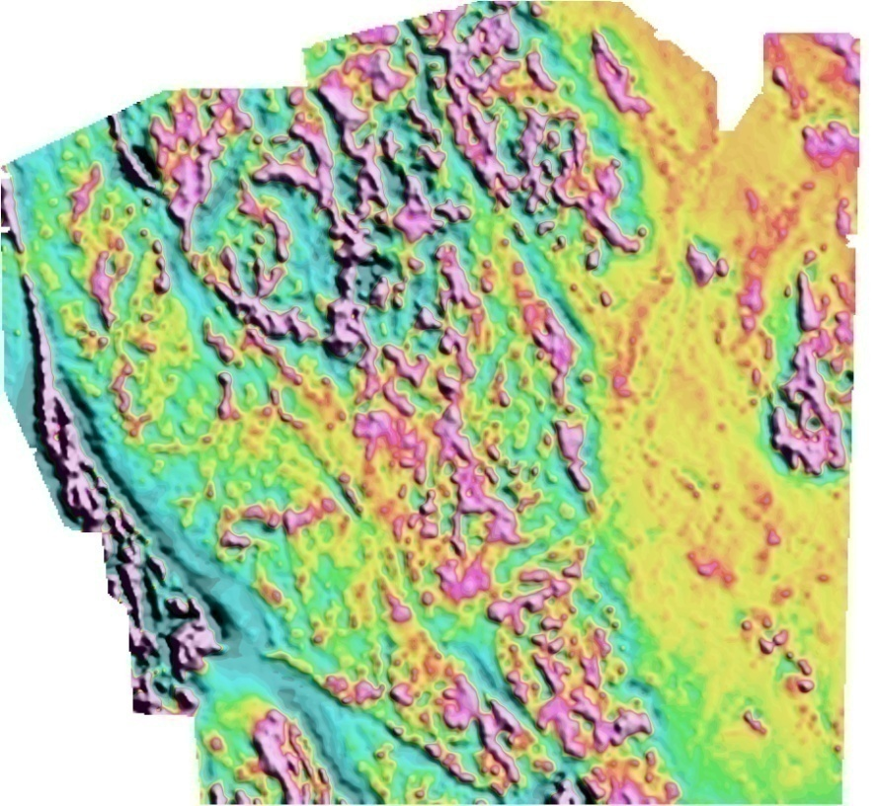
Tri-Directional Gradiometer Data
Notes:
Data from helicopter survey flown in mountains of British Columbia
Grid is 21 km across with 250m line spacing; normally tighter
Approx. 100 lines flown east-west
Nominal bird height was 35m

Slide 21
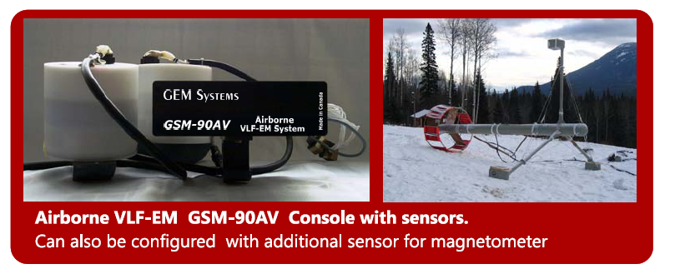
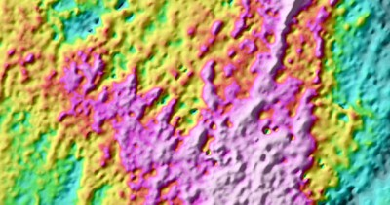
NEW VLF-EM Airborne Systems
VLF total field grid during a CMG survey in 2008
Notes:
Main advantage of gradiometers is their ability to resolve small targets, such as those on the flanks of larger anomalies.

Slide 22
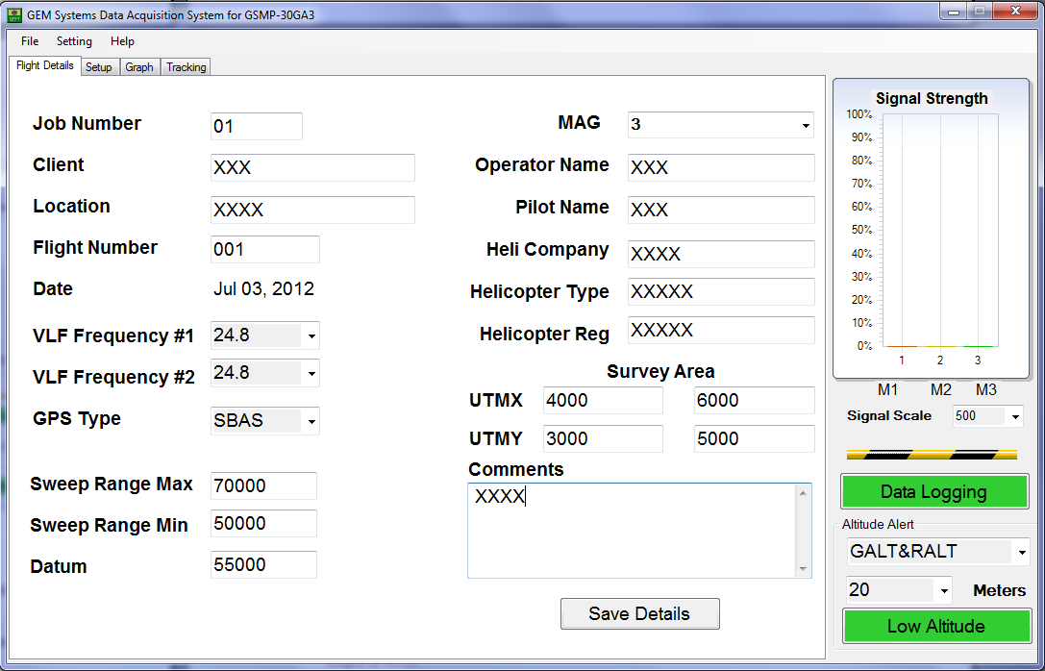
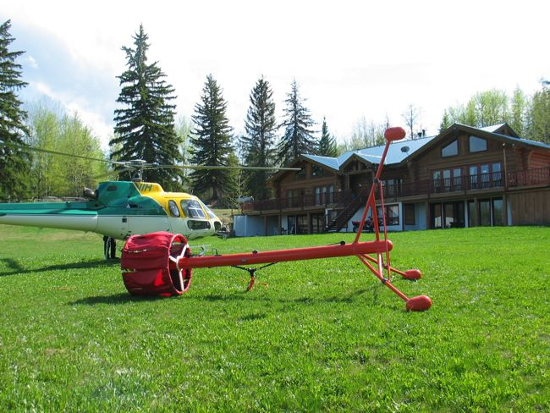
Advanced Airborne Systems
GEM DAS (Data Acquisition System)
Records in Real-time Data from:
Magnetometers Data
Radar Altimeter
GPS 20 HZ
2 VLF-EM
Flight Details
Notes:
Profile data plus vertical gradient data (bottom)

Slide 23
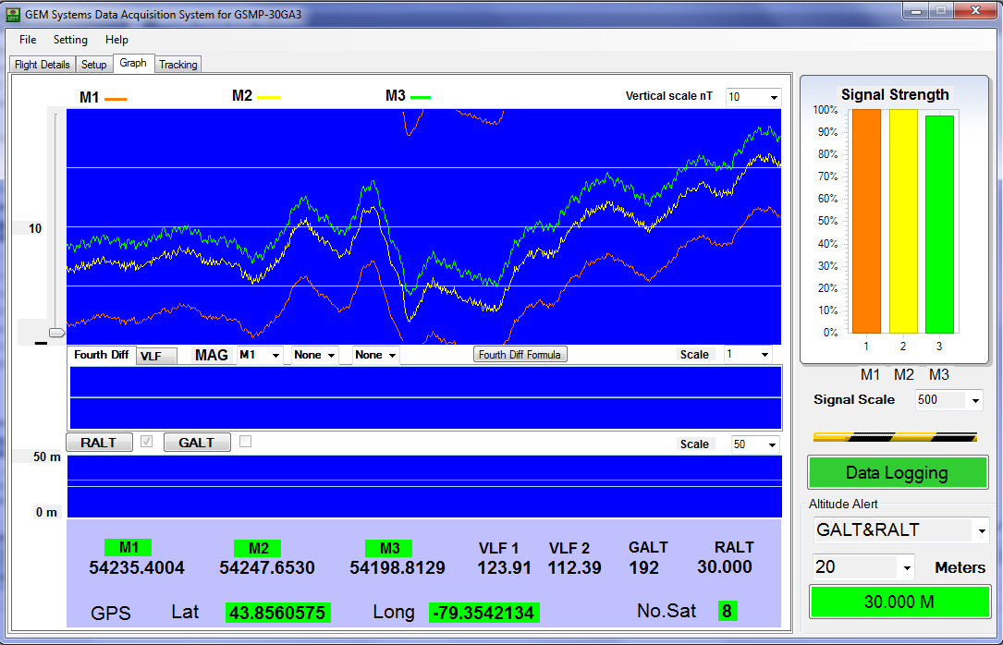
Advanced Airborne Systems
GEM DAS (Data Acquisition System)
Display in Real-time Data:
Magnetometers
Radar Altimeter
GPS Coordinates and #
Satellites
2 VLF-EM Frequency
Signal strength of Mag
Mags Lock Signal
Fourth Difference
Low Altitude Alarm
Color warnings
Notes:
Profile data plus vertical gradient data (bottom)

Slide 24
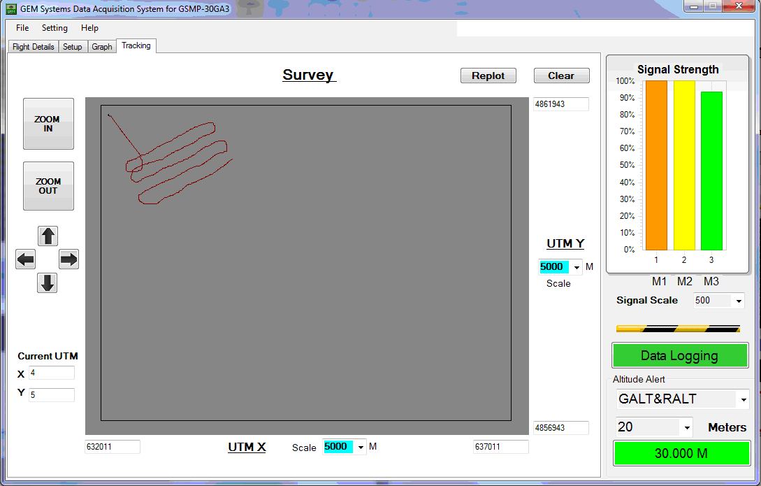
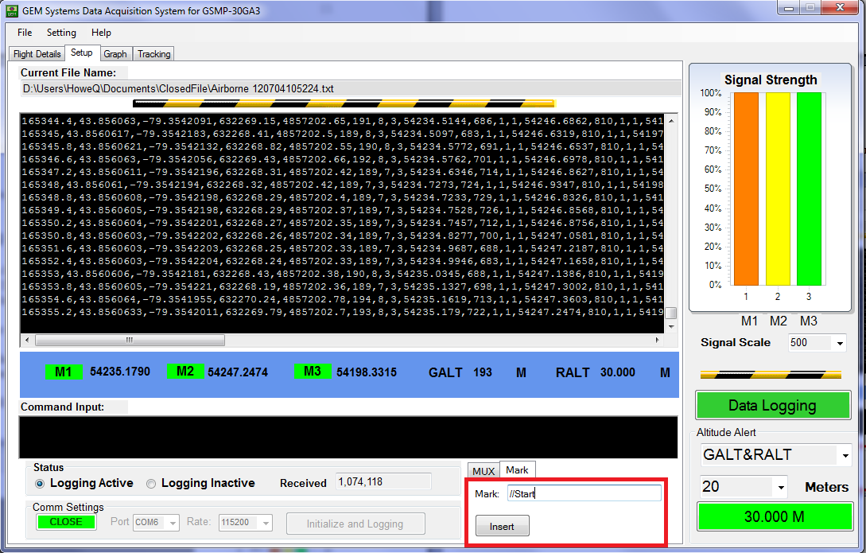
Advanced Airborne Systems
GEM DAS (Data Acquisition System)
Display in Real-time
Flight Tracing
Communications window
Notes:
Profile data plus vertical gradient data (bottom)

Slide 25
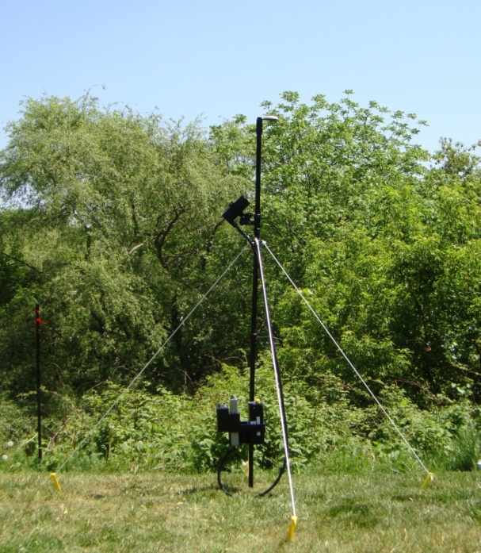
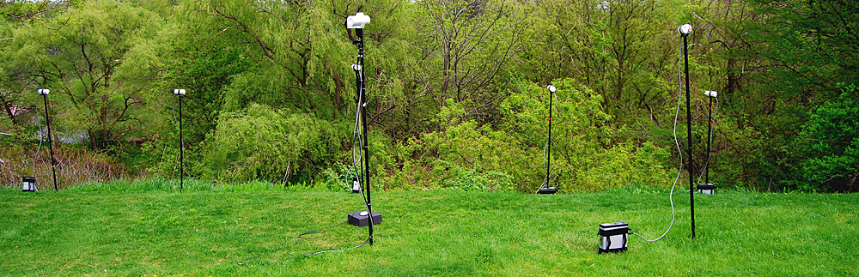
Base Stations
Overhauser or Potassium base stations available for effective elimination of diurnals:
Precise time synchronization of airborne and base station
units using a built-in GPS option
Multiple modes of operation:
  Flexible (up to 30 periods)
  Daily (specify daily hours)
  Immediate (start instantly)
Notes:
Final element of solution is the base station; different alternatives and capabilities available from GEM

Slide 26
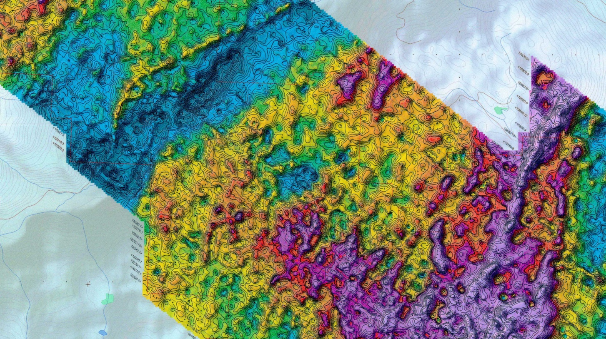
Sample Customer Maps
The Airborne Data presented for here is raw data no filtering, no line leveling.
VLF Total Field
Notes:
Profile data plus vertical gradient data (bottom)

Slide 27
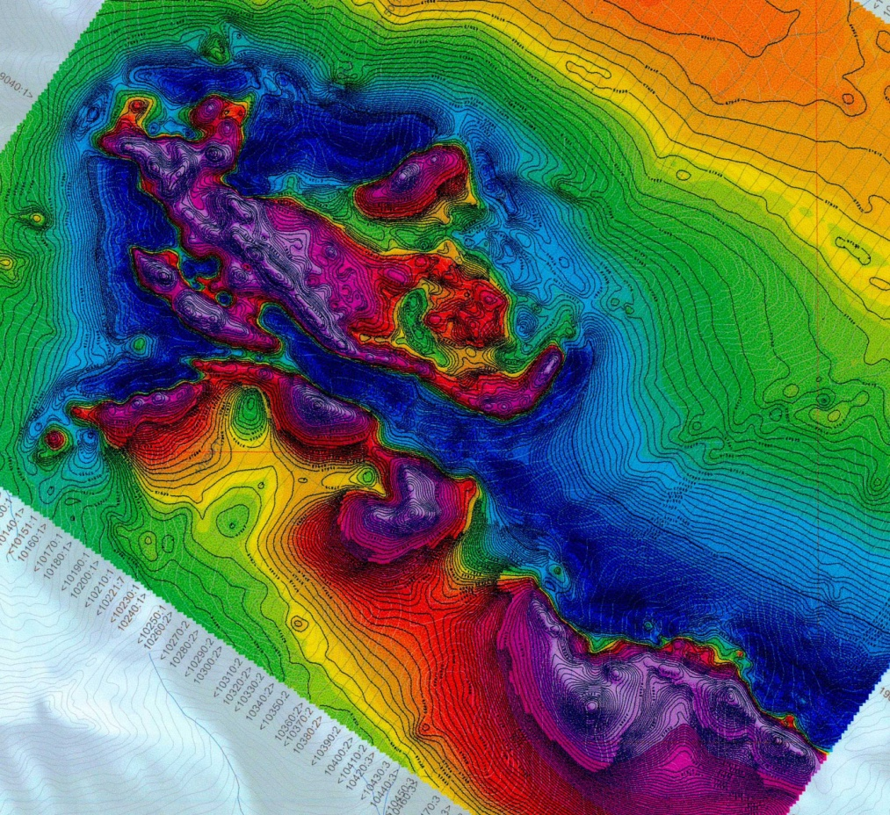
Sample Customer Maps
The Airborne Data presented for here is raw data no filtering, no line leveling.
Total Magnetic Intensity
Notes:
Profile data plus vertical gradient data (bottom)

Slide 28
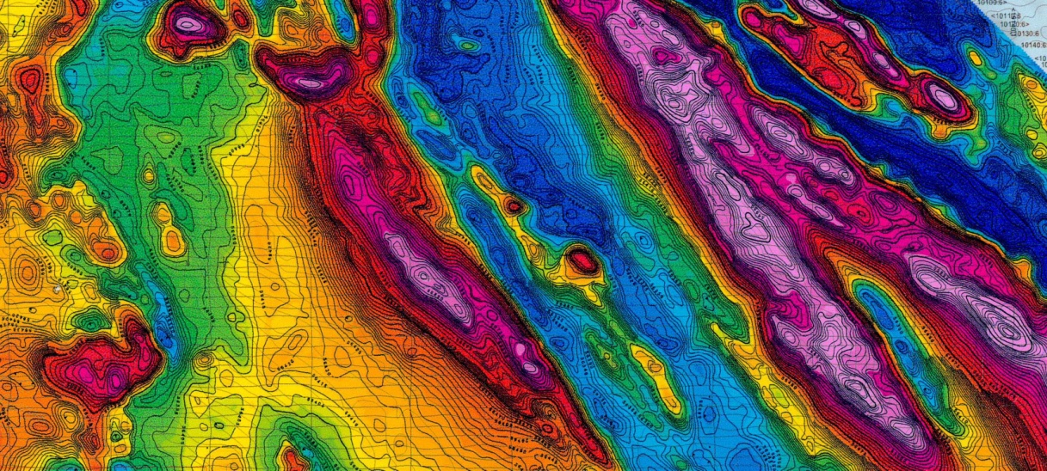
Sample Customer Maps
The Airborne Data presented for here is raw data no filtering, no line leveling.
Total Magnetic Intensity
Notes:
Variety of groups now offering survey services using Unmanned Vehicles.

Slide 29
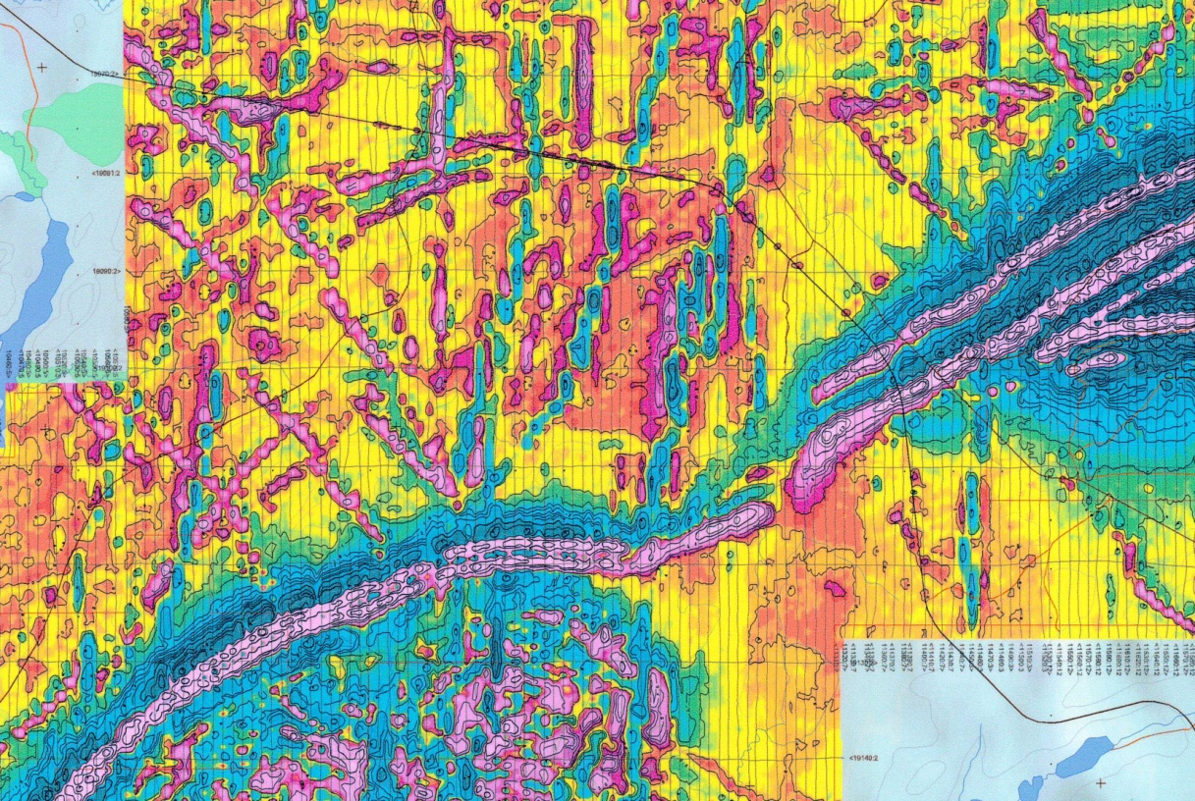
Sample Customer Maps
The Airborne Data presented for here is raw data no filtering, no line leveling.
Measured Vertical Magnetic Gradient
Notes:
Solutions are simple; consisting of electronics, acquisition, sensor and GPS
Data can be transferred optionally in real time or downloaded post-survey

Slide 30
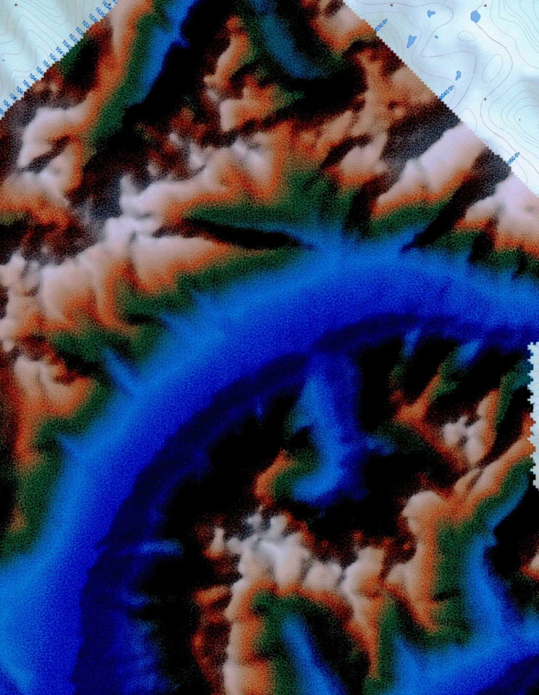
Sample Customer Maps
The Airborne Data presented for here is raw data no filtering, no line leveling.
Digital Terrain Model
Notes:
Solutions are simple; consisting of electronics, acquisition, sensor and GPS
Data can be transferred optionally in real time or downloaded post-survey

Slide 31
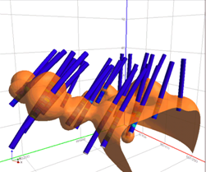
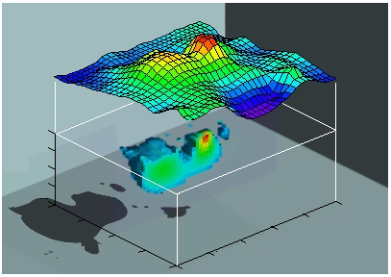
Sample Customer Maps
Magnetic Inversion
Three dimensional drill core analysis
Drill collar selection based on optimal intersections
Example Inversion Modeling (Li, 1996)
Notes:
EM Electromagnetic

Slide 32
Potassium – Specifications
Sensitivity: 0.5 pT
Resolution: 0.0001 nT
Absolute Accuracy: +/- 0.05 nT
Dynamic Range: 10,000 to 120,000 nT
Gradient Tolerance: 35,000 nT /m
Sensor Angle: Optimum angle 30° between sensor
head axis and field vector
Heading Error: <0.05 nT between 10° to 80° and 360° full
rotation about axis
Notes:
Summary of specifications

Slide 33

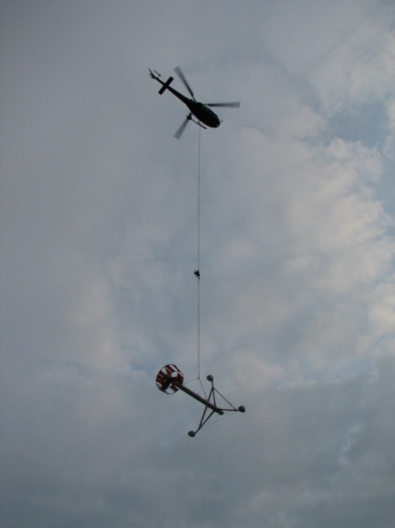
Conclusion
GSMP-35A is a State of the Art System for airborne surveys
Tested, all ready flew over 200,000 line km
Its High Sensitivity and Unique absolute accuracy makes the
Perfect magnetometer for High Sensitivity Surveys
Results demonstrate the effectiveness of the system for High Resolution magnetic and gradiometric surveys
GEM Changing the Nature of Surveying

Slide 34

Thank you for your attention ...

